Slide 1
TYPES OF MOLECULAR SIMILARITY
Prepared By:
Asma Ishaq Tahir

Slide 2
CONTENTS
Introduction
Types of similarity
Comparison
Conclusion

Slide 3
INTRODUCTION
Similarity is a widely used concept
“The state or fact of being similar.”
In chemoinformatics,
Similar chemical features relevant for similarity assessment
Notes:
Molecular similarity is a widely used concept in “rational” drug design. Its use is based on the principle that structurally more similar molecules are more likely to exhibit similar properties than structurally less similar molecules. (A Point-Based Algorithm for Multiple 3D Surface Alignment of Drug-Sized Molecules ,A point-based algorithm for multiple superposition of three-dimensional surfaces of drug molecules)

Slide 4
TYPES OF MOLECULAR SIMILARITY

Slide 5
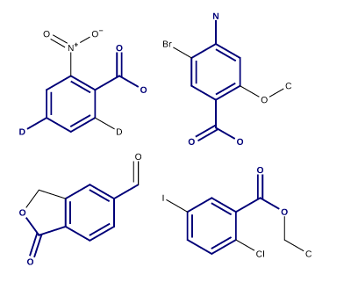
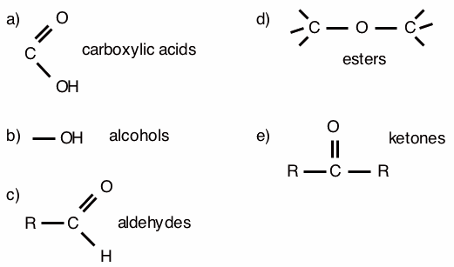
CHEMICAL AND MOLECULAR SIMILARITY
Chemical Similarity
Molecular Similarity
Physicochemical characteristics
E.g. solubility, boiling point
Descriptors – reaction time, functional groups
Structural features
E.g. shared substructures, topologies
Descriptors – aromaticity
Notes:
Chemical- descriptor(functional groups), mol (stru of compud , substru)

Slide 6
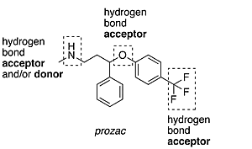
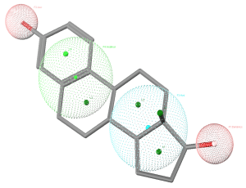
2D AND 3D SIMILARITY
2D Similarity
3D Similarity
2D structure representation
Molecular graphs
Example:
HBond acceptor number
Hbond donor number
Rotatable bonds number
3D conformation
Multiple conformations
Example:
Surface representation
Pharmacophore keys
Notes:
2d molecular graph and hbond acceptor, 3d molecule (surface)
– multiple values for descriptor
-molecular graph - molecular graph or chemical graph is a representation of the structural formula of a chemical compound in terms of graph theory

Slide 7
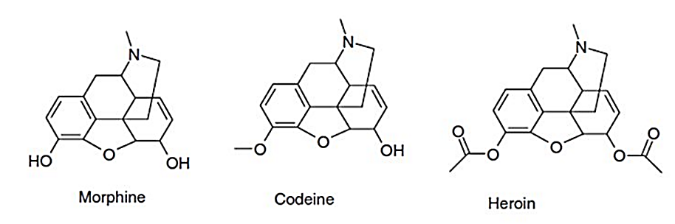
SIMILARITY PROPERTY PRINCIPLE (SPP)
Structurally similar molecules assumed to have similar biological activities
Notes:
Opiate describes any of the narcotic opioid alkaloids found in opium.
These alkaloids come from the sap of the opium poppy.
Opiates are a narcotic with analgesic or pain relieving effects .

Slide 8
MOLECULAR AND BIOLOGICAL SIMILARITY
Molecular Similarity
Biological Similarity
Based on structural features
E.g. shared substructures, topologies
Descriptors – aromaticity
Similarity Property Principle
Biological activity
Much difficult – specific activity values are not available

Slide 9
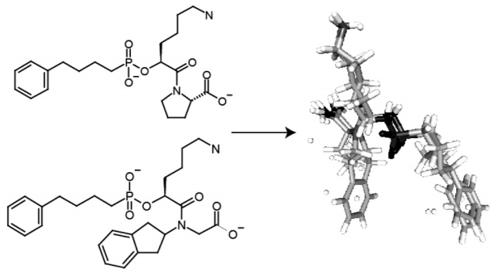
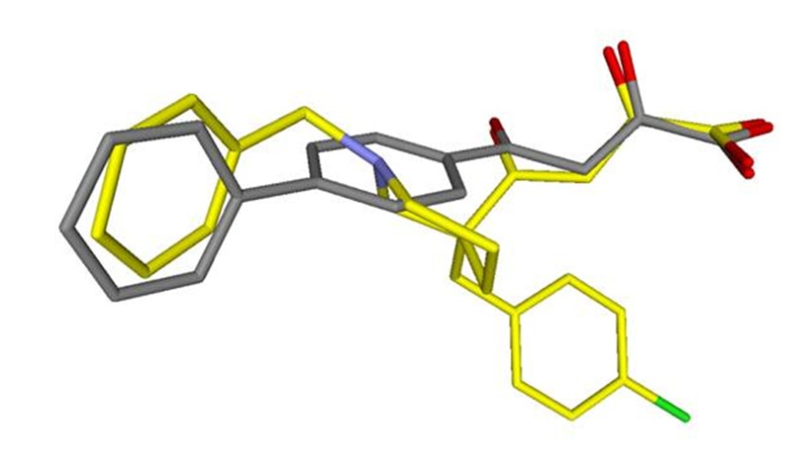
GLOBAL AND LOCAL SIMILARITY
Global Similarity
Local Similarity
Whole molecule
Structural information with the entire compound
Only selected atoms, groups or functionalities
Notes:
http://pubs.acs.org/doi/full/10.1021/bk-2016-1222.ch006

Slide 10
APPLICATIONS OF MACHINE LEARNING METHODS
Artificial neural network
Support vector machine
Notes:
For example, artificial neural networks (ANNs)198 are able to model flexibly a relationship between input and output variables, (An artificial neural network is an interconnected group of nodes, akin to the vast network of neurons in a brain.)
In recent years, support vector machines (SVMs)202,203 have been employed to molecular similarity problems. (support vector machines (SVMs, also support vector networks^{[1]}) are supervised learning models with associated learning algorithms that analyze data used for classification and regression analysis.)

Slide 11
CONCLUSION
Molecular similarity motivate many processes in chemoinformatics
Different similarity types – different significance
Different descriptors

Slide 12
REFERENCES
A. Bender, R.C. Glen, Molecular similarity: a key technique in molecular informatics, Org. Biomol. Chem., 2 (2004), pp. 3204–3218
G. Maggiora, et al. Molecular similarity in medicinal chemistry J. Med. Chem., 57 (2014), pp. 3186–3204
Similarity and Diversity, Alexandre Varnek, University of Strasbourg, France
http://infochim.u-strasbg.fr/CS3_2014/Slides/CS3_2014_Willett.pdf
https://www.chemcomp.com/journal/ph4/estradiol_query.gif
https://upload.wikimedia.org/wikipedia/commons/thumb/3/35/WikipediaHDonorAcceptor.png/300px-WikipediaHDonorAcceptor.png
http://olcc.ccce.divched.org/sites/olcc.ccce.divched.org/files/2015OLCCM6P1fig1.png
http://lifescience.opensource.epam.com/_images/sub_t18.svg
https://www.embl.de/chemcore/chemcore_services/computational_chemistry/insilico_screening/insilico_3l.jpg

Slide 13
THANK YOU

